Slide 1

Tablet Test Launch Results

Slide 2
Summary
The tablet launch team worked with the Management, the North and Downtown locations over the last quarter to determine how the tablets are going to help with the company’s overall objectives. The launch tests the tablets viability before rolling out for daily customer use. 50 customers were invited to participate in testing the tablets in a typical restaurant experience. They were sent a digital survey and findings were generally positive towards Sauce and Spoons goals of encouraging more orders and a more efficient and speedy dining experience.

Slide 3
Overview
The Tablet Launch team wanted to find out how the tablets would affect the dining experience of customers. This is measured by asking the test launch attendees questions such as those that follow:
Regarding the orders they placed using the tablet,
Its ease of use, how waitstaff are able to provide support,
And other questions regarding their overall dining experience.

Slide 4
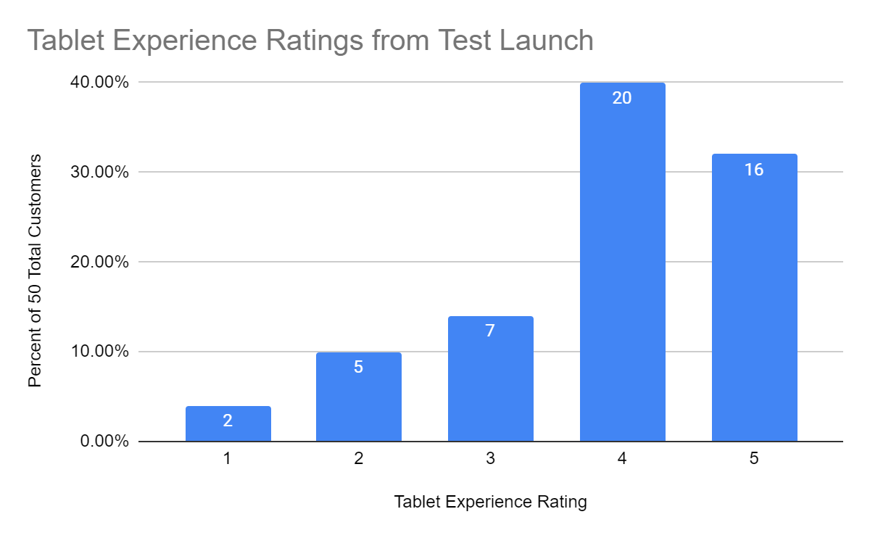
Findings
Measurements from supporting queries:
How easy the tablets were to use (30% Neutral, 48% Easy)
To order directly (28% Neutral, 46% Easy)
Quick checkout process (82% True)
Confidence in submitting payment (22% Neutral, 66% Confident)
No technical issues (88%)
More than 70% of attendees reported a positive experience with the use of the tablets. This experience is supported by positive comments regarding other questions relating to experience with the tablet.

Slide 5
Next Steps
The survey shows that the tablets contribute to Sauce and Spoon’s goals to encourage customers to order more, speed up table turnover, and to reduce comped meals.
However, there are still quite a number of users who were neutral to averse regarding some specific aspects of the tablet such as with its ease of use, confidence with payment, and quick checkout.
The first recommendation is to find out and resolve the reasons as to why some users experience technical issues with the tablets. According to some users, the issues they experienced were that the screen froze and that the tablets were glitchy. The team could work with the manufacturer to make sure that users don’t experience this again. Dining experience should be monitored again afterwards and check if the same issues reappear and how they also report on payment confidence, ease of use, and quicker checkout. Possibly, the technical issues contribute to their neutral to negative dining experience.

Slide 6
Next Steps
A second recommendation would be for sauce and spoon tablet team to focus on making sure that all orders are received and delivered correctly from and to the customers. Further investigation has to be done regarding the wrong orders that were brought out if it was because of the customers not being able to put their preferences properly on the tablets or if it was on the kitchen’s end that they weren't to read and work on the orders properly. This may be one of the reasons that customers did not report having a good experience with the tablets.

